Slide 1
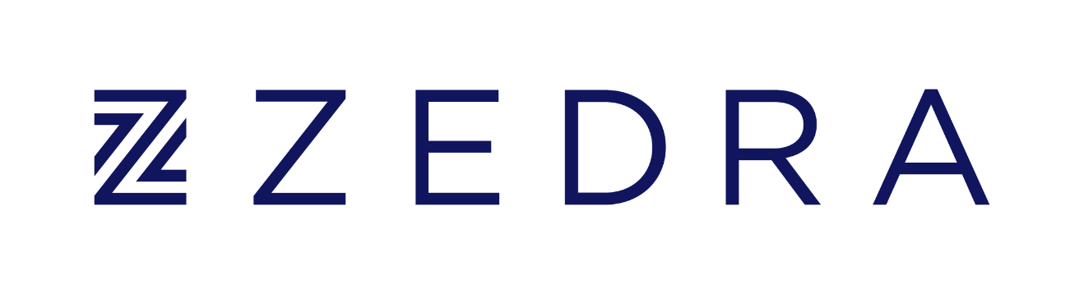
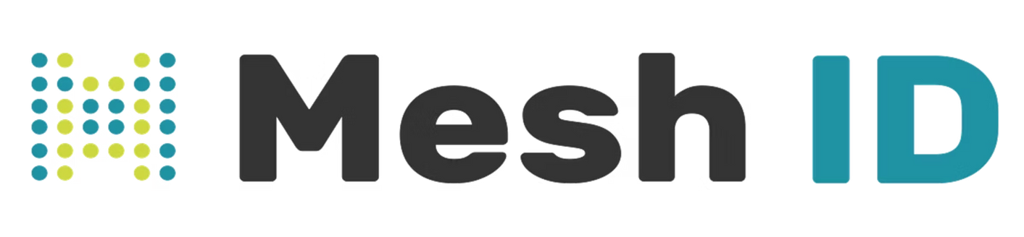

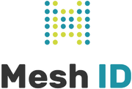
&
Digitalizing the Client Experience Across Diverse Trust & Corporate Service Lines.
The Objective
ZEDRA is a global provider of Corporate, Funds and Wealth solutions, supporting businesses, fund managers, high-net-worth individuals and families with the governance, administration and operational expertise needed to navigate complexity and achieve their long-term ambitions
With a business and reputation built on expert service and long-term client relationships, ZEDRA recognized that digitalizing the client experience was essential to maintaining their competitive edge while scaling operations.
Chris Field
Global Head of Operations, ZEDRA Group
Chris Field, Group Head of Operations, describes the focus of the partnership:
Organization
"We've been working with Mesh ID with a focus on digitalizing client experience."
ZEDRA Group
Sector
For a firm like ZEDRA - managing complex, multi-party relationships across diverse service lines - this wasn't about replacing personal service with technology. It was about removing friction, streamlining administration, and freeing relationship managers to focus on what they do best: guiding clients through complex corporate, funds and wealth matters.
Corporate Services, Fund Solutions, Private Wealth Services
Scale
1,400+ employees, 30+ offices, 17 jurisdictions
Why Mesh ID?
Choosing the right technology partner was critical to ZEDRA they conducted a comprehensive evaluation and selected Mesh ID following a robust RFP process for several reasons:
Security
Industry Knowledge
Ability to handle complexity and flexibility within workflows to suit ZEDRA’s processes.
Security stood out immediately.
For a firm entrusted with managing client wealth and sensitive personal information, this was non-negotiable:
"The technology is advanced and has a strong focus on security, which is really important to us as a company."
Notes:
1

Slide 2
But technology credentials alone weren't enough.
What differentiated Mesh ID from other vendors was something harder to find - genuine understanding of ZEDRA's world:
"Another key factor for selecting Mesh ID as a partner has been the industry knowledge. We know that they bring expertise from previous roles and they know the challenges that we have in trying to digitalize end-to-end client experiences."
This industry expertise meant Mesh ID understood the nuances: the importance of handling multiple parties within a single journey; the need for flexibility between digital self-service and high-touch guided approaches; the reality that trust administration involves ongoing lifecycle events, not just one-time onboarding.
ZEDRA wasn't looking for a generic fintech that would require months of education about their business. They wanted a partner who already understood the challenges of digitalizing client experiences in the trust and corporate services sector.
Flexibility has proven essential.
ZEDRA operates across multiple jurisdictions and service lines - from trust administration to fund services to pension governance.
This flexibility means ZEDRA can:
This flexibility means ZEDRA can:
Configure workflows differently for different trust types and jurisdictions
1
Configure workflows differently for different trust types and jurisdictions
A rigid, one-size-fits-all platform would have created as many problems as it solved. Instead, Mesh ID's configurability has allowed ZEDRA to adapt the solution to their specific needs:
Adapt the platform as their business evolves, without costly redevelopment
2
Adapt the platform as their business evolves, without costly redevelopment
Offer clients the choice between digital self-service and a more guided, relationship-led approach
"We see it as a flexible product and that's again really important to us given our diversity and service lines."
3
Offer clients the choice between digital self-service and a more guided, relationship-led approach
The Result
A strategic asset, not just an operational tool.
Rather than a point solution that addressed a single pain point, Mesh ID has become integral to ZEDRA's broader digital transformation:
"We see there's lots further opportunity to use Mesh ID across those services and we look forward to continuing the journey with them and see the platform as a strategic enabler to continue our digital transformation roadmap."
This speaks to the depth of the partnership. The relationship has evolved from vendor-client to a genuine strategic partnership.
ZEDRA isn't just using Mesh ID for one use case - they're actively identifying new opportunities to extend the platform across their business.
Notes:
2

